Slide 1


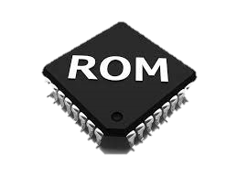
Read only memory (rom)

Slide 2
MEET OUR TEAM
Name :Namra Mevada Roll no. :61
Branch :IT
Batch :2A
Enrollment no. :2200217210049 Name :Ekal Sorathiya Roll no. : 62
Branch :CE
Batch :2A Enrollment no. :22002170110028 Name :Bhavya Patel Roll no. :63
Branch :CE
Batch :2A Enrollment no. :22002170110106
Name :Yasvi Vaghasiya Roll no. :70
Branch :CE
Batch :2A Enrollment no. :22002170110199
Name :Chirag Patel Roll no. :81
Branch :CE
Batch :2A Enrollment no. :22002170110107

Slide 3
PROJECT OUTLINE
INTRODUCTION
HISTORY
TYPES OF ROM
MAJOR DIFFERENCE
ADVANTAGES AND DISADVANTAGES
APPLICATION

Slide 4
Introduction
ROM stands for Read-Only Memory.
It only reads the programs and data stored in it.
It is non-volatile memory that is used to stores important information which is used to operate the system.
It is the primary unit of the computer system.
The information stored in ROM is in binary format.
It is also known as permanent memory.

Slide 5
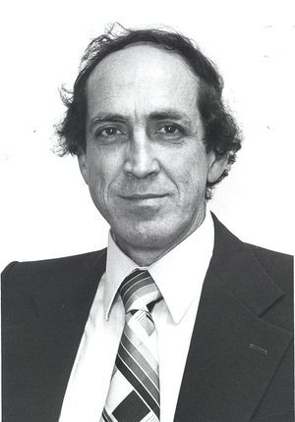
History
The concept of read-only memory (ROM) was first introduced by Robert Dennard in the 1960s.
Dennard was a researcher at IBM and the inventor of dynamic random-access memory (DRAM), a type of memory that is used in computers and other electronic devices to store data temporarily.
The very first ROMs were hard-wired devices that contained a pre-programmed set of data or instructions.
These kind of ROMs are known as Masked ROMs, which are inexpensive.
During the design phase in the manufacturing process of a MROM, a software mask is burned directly onto the chip.
ROBERT DENNARD

Slide 6
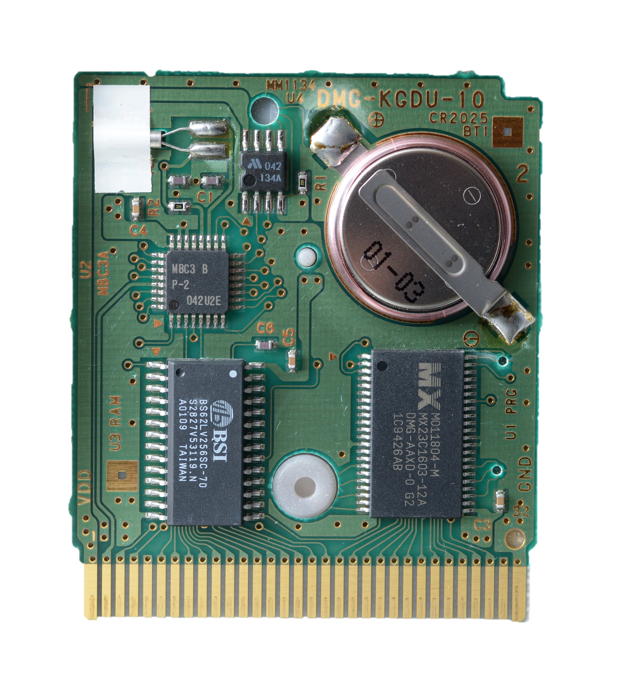
TYPES OF ROM
ROMs are of five types:
Masked read only memory(MROM)
Programmable Read Only Memory(PROM)
Erasable Programmable Read Only Memory(EPROM)
Electrically Erasable Programmable Read Only Memory(EEPROM)
Flash Memory

Slide 7
1. Masked Read Only Memory (MROM)
Mask ROM (MROM) chips are used in computer systems that require long-term sustainability.
Examples of computer systems that use mask ROM chips or MROM chips include network operating systems and server operating systems.
To produce mask rom (MROM) chips, integrated circuits (ICS) are masked during the design phase of the semiconductor fabrication process.
In its simplest form, a semiconductor is defined as a material that is half-conductive and half-insular, and that can be altered by electrical impulses.

Slide 8
2. Programmable Read Only Memory (PROM)
PROM memory is non-volatile and may be written only once.
An example of a prom is a computer bios in early computers.
A programmable read-only memory (prom) or field programmable read-only memory (FPROM) or one-time programmable non-volatile memory (OTP NVM) is a form of digital memory where the setting of each bit is locked by a fuse or ANTIFUSE.
It can be programmed only once and is not erasable.

Slide 9
3. Erasable Programmable Read only Memory (EPROM)
It form of computer memory that does not lose its content when the power supply is cut off and that can be erased and reused.
EPROMS are generally employed for programs designed for repeated use but that can be upgraded with a later version of a program.
EPROM is non-volatile so it retains its memory even without power.
No external memory is required, therefore is quite effective.
Examples of EPROMS you can hold in your hand include compact flash, smart memory, memory sticks etc.

Slide 10
4. Electrically Erasable Programmable Read-Only Memory (EEPROM)
EEPROM is a type of non-volatile ROM that enables individual bytes of data to be erased and reprogrammed.
That is why EEPROM chips are known as byte erasable chips.
It is programmed and erased electrically.
It can be erased and reprogrammed about 10,000 times.
In EEPROM any location can be selectively erased, rather than erasing entire chip.
In EEPROM both erasing and programming take about 4 to 10 ms.

Slide 11
5. Flash Memory
Flash memory, also known as flash storage, is a type of nonvolatile memory that erases data in units called blocks and rewrites data at the byte level.
Flash memory is widely used for storage and data transfer in consumer devices, enterprise systems and industrial applications.
Flash memory is a long-life and non-volatile storage chip that is widely used in embedded systems.
The most common types of flash memory are SD, MICRO SD, and compact flash. Memory cards and USB drives are in widespread use and are ideal for a wide range of applications.

Slide 12
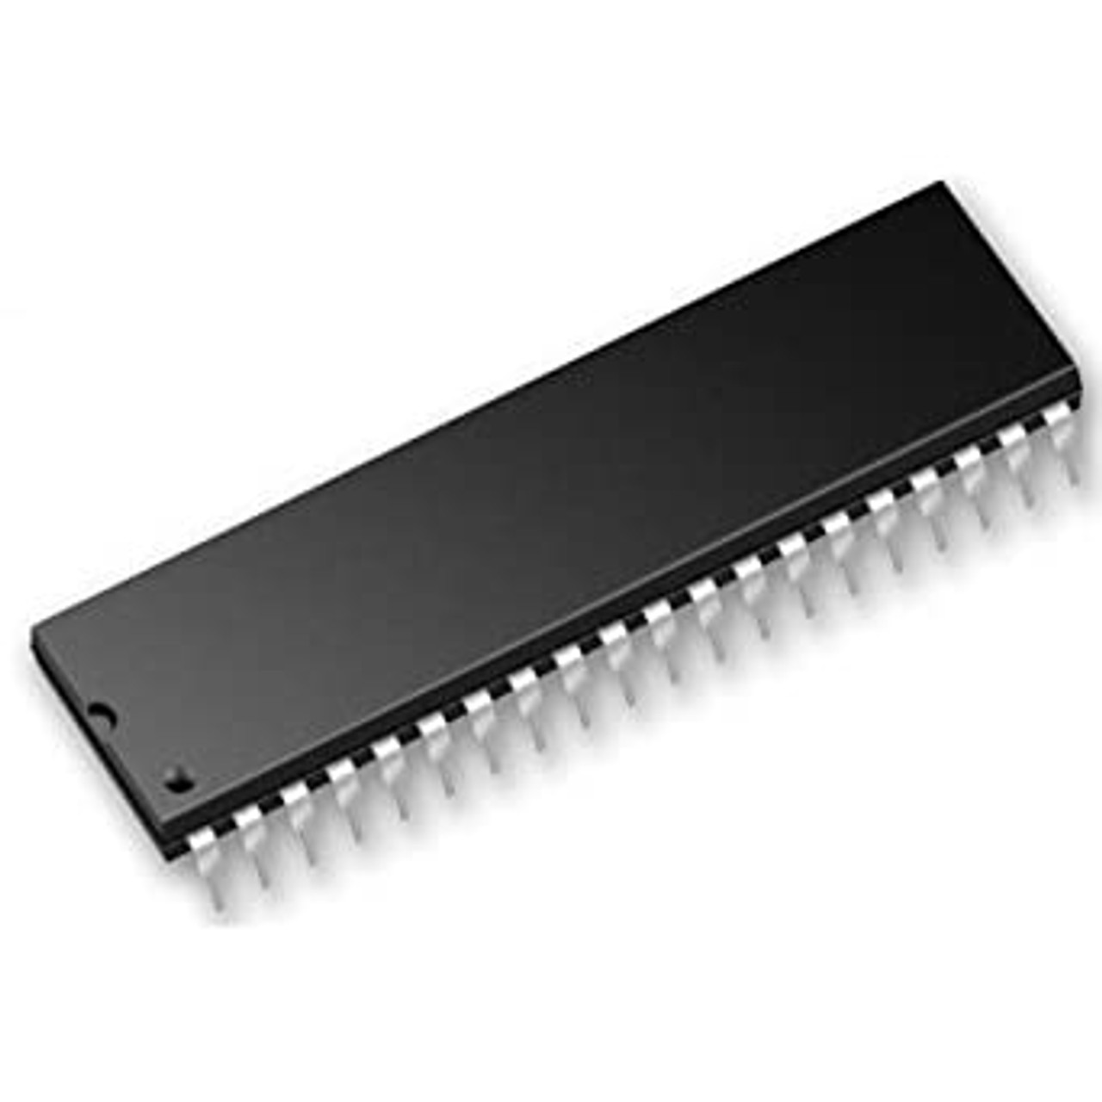
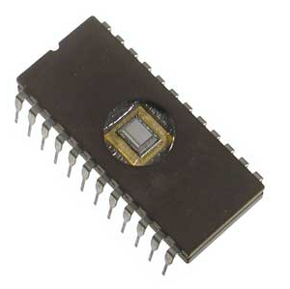
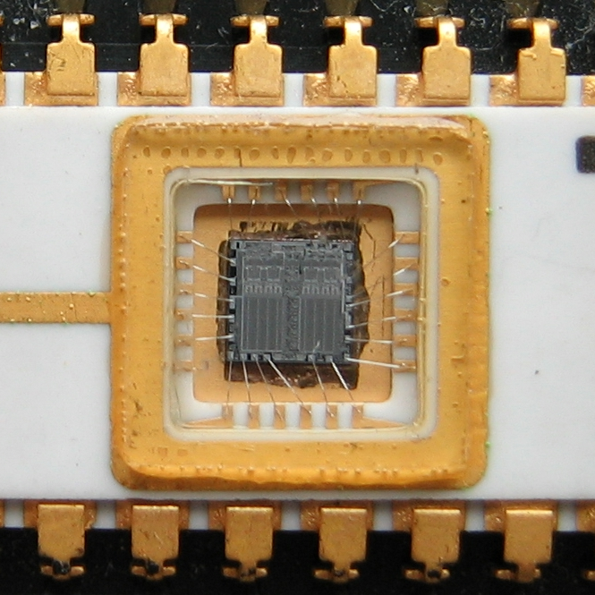
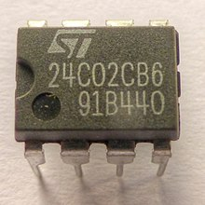
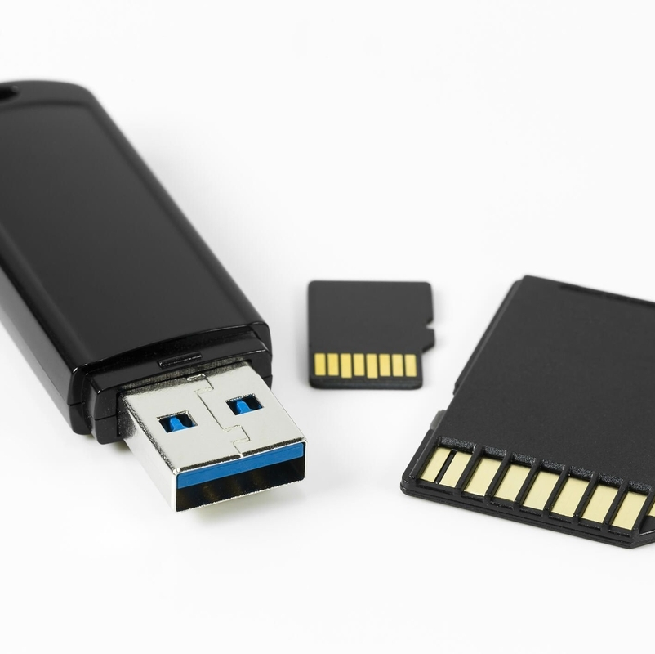
Major Difference
MASK ROM
PROM
EPROM
EEPROM
FLASH MEMORY
Programs and instruction are stored at the time of manufacturing.
It can only store data once after it is manufactured.
It can Stored data many times by upgrading and reusing.
It allows Individual bytes to be erased and changes .
It is an advanced version of EEPROM.

Slide 13
Advantages
Its static nature means it does not require refreshing.
It is easy to test.
Rom is more reliable than ram since it is non-volatile in nature and cannot be altered or accidentally changed.
The contents of the rom can always be known and verified.
Less expensive than RAM.

Slide 14
Disadvantages
One of the most significant disadvantages of ROM is its slow speed and inability to store large amounts of information.
If an MROM contains a design error, you cannot use it, and the code requires replacement.
After burning or programming a prom chip, you cannot erase or change its data.
ROM is a slower type of memory.
ROM memory is capable of reading data only, cannot be changed the ROM data.

Slide 15
APPLICATION
ROM provides the necessary instructions for communication between various hardware components.
It is essential for the storage and operation of the BIOS.
It is also be used for basic data management, to hold software for basic processes of utilities and to read and write to peripheral devices.

Slide 16
THANK YOU…

